Slide 1
Chapter 5 – System Modeling
Instructor
Dr. Sultan S. Alqahtani
ssalqahtani@imamu.edu.sa
Note: These are a slightly modified version of Ch5 slides available from the author’s site http://www.cs.st-andrews.ac.uk/~ifs/Books/SE9/

Slide 2
Topics covered
Context models
Interaction models
Structural models
Behavioral models
Model-driven engineering

Slide 3
System modeling
System modeling is the process of developing abstract models of a system, with each model presenting a different view or perspective of that system.
System modeling has now come to mean representing a system using some kind of graphical notation, which is now almost always based on notations in the Unified Modeling Language (UML).
System modelling helps the analyst to understand the functionality of the system and models are used to communicate with customers.

Slide 4
UML diagram types
Activity diagrams, which show the activities involved in a process or in data processing .
Use case diagrams, which show the interactions between a system and its environment.
Sequence diagrams, which show interactions between actors and the system and between system components.
Class diagrams, which show the object classes in the system and the associations between these classes.
State diagrams, which show how the system reacts to internal and external events.

Slide 5
Use of graphical models
As a means of facilitating discussion about an existing or proposed system
Incomplete and incorrect models are OK as their role is to support discussion.
As a way of documenting an existing system
Models should be an accurate representation of the system but need not be complete.
As a detailed system description that can be used to generate a system implementation
Models have to be both correct and complete.

Slide 6
Context models
Context models are used to illustrate the operational context of a system - they show what lies outside the system boundaries.
Social and organisational concerns may affect the decision on where to position system boundaries.
Architectural models show the system and its relationship with other systems.

Slide 7
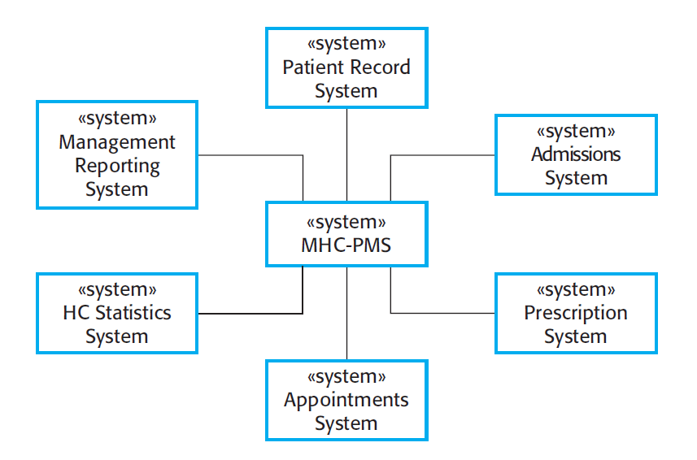
The context of the MHC-PMS

Slide 8
Interaction models
Modeling user interaction is important as it helps to identify user requirements.
Modeling system-to-system interaction highlights the communication problems that may arise.
Modeling component interaction helps us understand if a proposed system structure is likely to deliver the required system performance and dependability.
Use case diagrams and sequence diagrams may be used for interaction modelling.

Slide 9
Use case modeling
Use cases were developed originally to support requirements elicitation and now incorporated into the UML.
Each use case represents a discrete task that involves external interaction with a system.
Actors in a use case may be people or other systems.
Represented diagrammatically to provide an overview of the use case and in a more detailed textual form.

Slide 10
Use Case
“A use case specifies the behavior of a system or a part of a system, and is a description of a set of sequences of actions, including variants, that a system performs to yield an observable result of value to an actor.”
- The UML User Guide, [Booch,99]
“An actor is an idealization of an external person, process, or thing interacting with a system, subsystem, or class. An actor characterizes the interactions that outside users may have with the system.”
- The UML Reference Manual, [Rumbaugh,99]

Slide 11
Use Case (Cont’d)
Register for Courses
A use case is rendered as an ellipse in a use case diagram. A use case is always labeled with its name.

Slide 12
Use Case (Cont’d)
An actor is rendered as a stick figure in a use case diagram. Each actor participates in one or more use cases.
Student

Slide 13
Use Case (Cont’d)
Actors can participate in a generalization relation with other actors.
Student
Person

Slide 14
Use Case (Cont’d)
Actors may be connected to use cases
only by associations.
Register for Courses
Student

Slide 15
Use Case (Cont’d)
Here we have a Student interacting with the Registrar and the
Billing System via a “Register for Courses” use case.
Billing System
Student
Register for Courses
Registrar

Slide 16
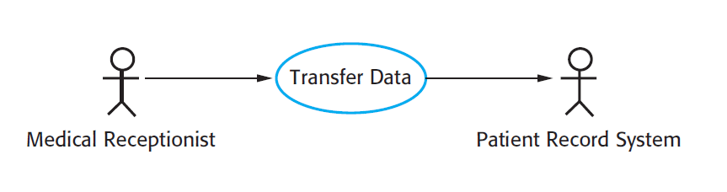
Transfer-data use case
A use case in the MHC-PMS

Slide 17
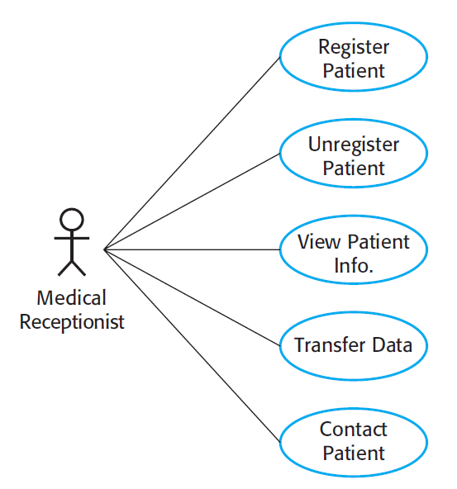
Use cases in the MHC-PMS involving the role ‘Medical Receptionist’

Slide 18
Sequence diagrams
Sequence diagrams are part of the UML and are used to model the interactions between the actors and the objects within a system.
A sequence diagram shows the sequence of interactions that take place during a particular use case or use case instance.
The objects and actors involved are listed along the top of the diagram, with a dotted line drawn vertically from these.
Interactions between objects are indicated by annotated arrows.

Slide 19
Sequence Diagram
an Order Line
An object in a sequence diagram is rendered
as a box with a dashed line descending from it.
The line is called the object lifeline, and it
represents the existence of an object over a
period of time.

Slide 20
Sequence Diagram
an Order Line
a Stock Item
Messages are rendered as horizontal
arrows being passed from object to
object as time advances down the
object lifelines. Conditions ( such as
[check = “true”] ) indicate when a
message gets passed.
check()
[check = “true”] remove()

Slide 21
Sequence Diagram
an Order Line
a Stock Item
check()
Notice that the bottom arrow is different. The arrow head is not solid, and there is no accompanying message.
This arrow indicates a return from a previous message, not a new message.
[check = “true”] remove()

Slide 22
Sequence Diagram
an Order
a Order Line
* prepare()
An iteration marker, such as * (as shown), or *[i = 1..n] , indicates that a message will be repeated as indicated.
Iteration
marker

Slide 23
an Order Entry window
an Order
an Order Line
a Stock Item
[Fowler,97]
prepare()
Condition
* prepare()
Object
check()
Message
[check = “true”] remove()
needsToReorder()
Iteration
Return
Self-Delegation
[needsToReorder = “true”]
new
A Reorder Item
[check = “true”] new
A Delivery Item
Creation

Slide 24
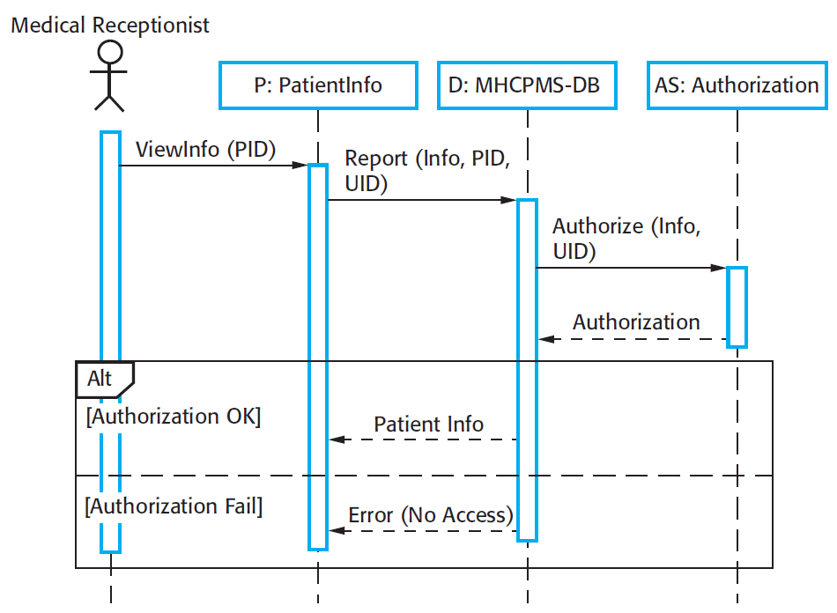
Sequence diagram for View patient information
Alternative scenario

Slide 25
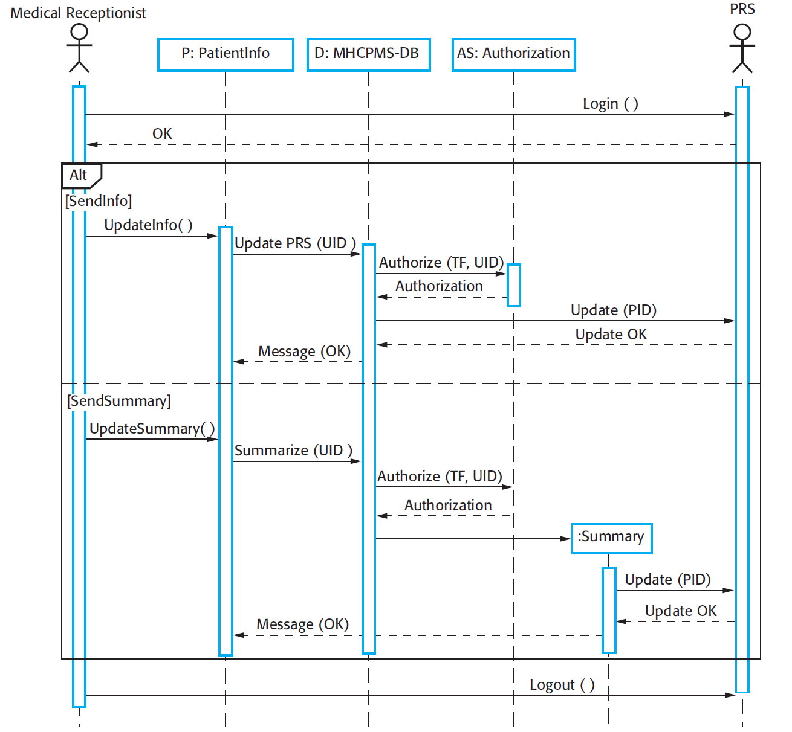
Sequence diagram for Transfer Data

Slide 26
Structural models
Structural models of software display the organization of a system in terms of the components that make up that system and their relationships.
Structural models may be static models, which show the structure of the system design, or dynamic models, which show the organization of the system when it is executing.
You create structural models of a system when you are discussing and designing the system architecture.

Slide 27
Class diagrams
Class diagrams are used when developing an object-oriented system model to show the classes in a system and the associations between these classes.
An object class can be thought of as a general definition of one kind of system object.
An association is a link between classes that indicates that there is some relationship between these classes.
When you are developing models during the early stages of the software engineering process, objects represent something in the real world, such as a patient, a prescription, doctor, etc.

Slide 28
Classes
A class is a description of a set of
objects that share the same attributes,
operations, relationships, and semantics.
Graphically, a class is rendered as a
rectangle, usually including its name,
attributes, and operations in separate,
designated compartments.
ClassName
attributes
operations

Slide 29
Class Names
ClassName
The name of the class is the only required tag in the graphical representation of a class. It always appears in the top-most compartment.
attributes
operations

Slide 30
Class Attributes
Person
name : String
address : Address
birthdate : Date
ssn : Id
An attribute is a named property of a
class that describes the object being modeled.
In the class diagram, attributes appear in
the second compartment just below the
name-compartment.

Slide 31
Class Attributes (Cont’d)
Attributes are usually listed in the form:
attributeName : Type
A derived attribute is one that can be
computed from other attributes, but
doesn’t actually exist. For example,
a Person’s age can be computed from
his birth date. A derived attribute is
designated by a preceding ‘/’ as in:
/ age : Date
Person
name : String
address : Address
birthdate : Date
/ age : Date
ssn : Id

Slide 32
Class Attributes (Cont’d)
Person
+ name : String
# address : Address
# birthdate : Date
/ age : Date
- ssn : Id
Attributes can be:
+ public
# protected
- private
/ derived

Slide 33
Class Operations
Person
name : String
address : Address
birthdate : Date
ssn : Id
eat
sleep
work
play
Operations describe the class behavior
and appear in the third compartment.

Slide 34
Class Operations (Cont’d)
PhoneBook
newEntry (n : Name, a : Address, p : PhoneNumber, d : Description)
getPhone ( n : Name, a : Address) : PhoneNumber
You can specify an operation by stating its signature: listing the name, type, and default value of all parameters, and, in the case of functions, a return type.

Slide 35
Depicting Classes
When drawing a class, you needn’t show attributes and operation in every diagram.
Person
Person
Person
name : String
birthdate : Date
ssn : Id
Person
name
address
birthdate
eat()
sleep()
work()
play()
Person
eat
play

Slide 36
Class Responsibilities
A class may also include its responsibilities in a class diagram.
A responsibility is a contract or obligation of a class to perform a particular service.
SmokeAlarm
Responsibilities
-- sound alert and notify guard station
when smoke is detected.
-- indicate battery state

Slide 37
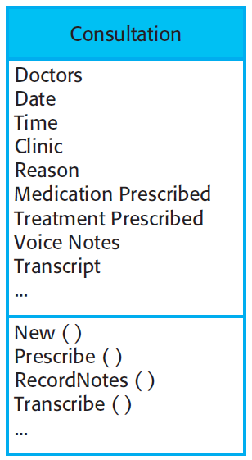
The Consultation class

Slide 38
Relationships
In UML, object interconnections (logical or physical), are
modeled as relationships.
There are three kinds of relationships in UML:
dependencies
generalizations
associations

Slide 39
Association Relationships
If two classes in a model need to communicate with each other, there must be link between them.
An association denotes that link.
Student
Instructor

Slide 40
Association Relationships (Cont’d)
We can indicate the multiplicity of an association by adding multiplicity adornments to the line denoting the association.
The example indicates that a Student has one or more Instructors:
Student
Instructor
1..*

Slide 41
Association Relationships (Cont’d)
The example indicates that every Instructor has one or more Students:
Student
Instructor
1..*

Slide 42
Association Relationships (Cont’d)
We can also indicate the behavior of an object in an association (i.e., the role of an object) using rolenames.
teaches
learns from
Student
Instructor
1..*
1..*

Slide 43
Association Relationships (Cont’d)
We can also name the association.
membership
Student
Team
1..*
1..*

Slide 44
Association Relationships (Cont’d)
We can specify dual associations.
member of
Student
Team
1..*
1..*
1
president of
1..*

Slide 45
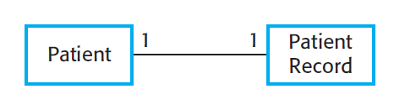
UML classes and association

Slide 46
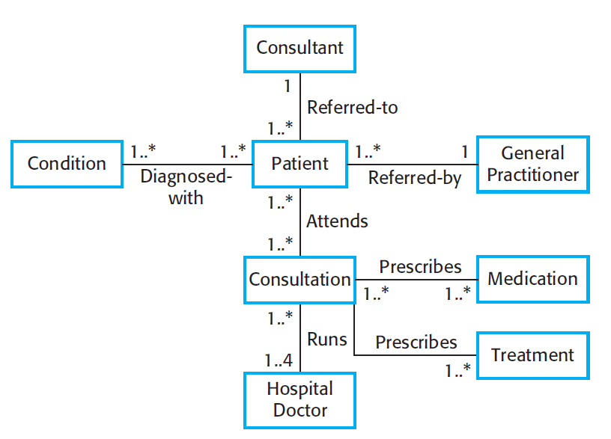
Classes and associations in the MHC-PMS

Slide 47
Key points
A model is an abstract view of a system that ignores system details. Complementary system models can be developed to show the system’s context, interactions, structure and behavior.
Context models show how a system that is being modeled is positioned in an environment with other systems and processes.
Use case diagrams and sequence diagrams are used to describe the interactions between users and systems in the system being designed. Use cases describe interactions between a system and external actors; sequence diagrams add more information to these by showing interactions between system objects.
Structural models show the organization and architecture of a system. Class diagrams are used to define the static structure of classes in a system and their associations.

Slide 48
Chapter 5 – System Modeling
Lecture 2

Slide 49
Generalization
Generalization is an everyday technique that we use to manage complexity.
Rather than learn the detailed characteristics of every entity that we experience, we place these entities in more general classes (animals, cars, houses, etc.) and learn the characteristics of these classes.
This allows us to infer that different members of these classes have some common characteristics e.g. squirrels and rats are rodents.

Slide 50
Generalization
In modeling systems, it is often useful to examine the classes in a system to see if there is scope for generalization. If changes are proposed, then you do not have to look at all classes in the system to see if they are affected by the change.
In object-oriented languages, such as Java, generalization is implemented using the class inheritance mechanisms built into the language.
In a generalization, the attributes and operations associated with higher-level classes are also associated with the lower-level classes.
The lower-level classes are subclasses inherit the attributes and operations from their superclasses. These lower-level classes then add more specific attributes and operations.

Slide 51
Generalization Relationships
Person
A generalization connects a subclass
to its superclass. It denotes an
inheritance of attributes and behavior
from the superclass to the subclass and
indicates a specialization in the subclass
of the more general superclass.
Student

Slide 52
Generalization Relationships (Cont’d)
UML permits a class to inherit from multiple superclasses, although some programming languages (e.g., Java) do not permit multiple inheritance.
Student
Employee
TeachingAssistant

Slide 53
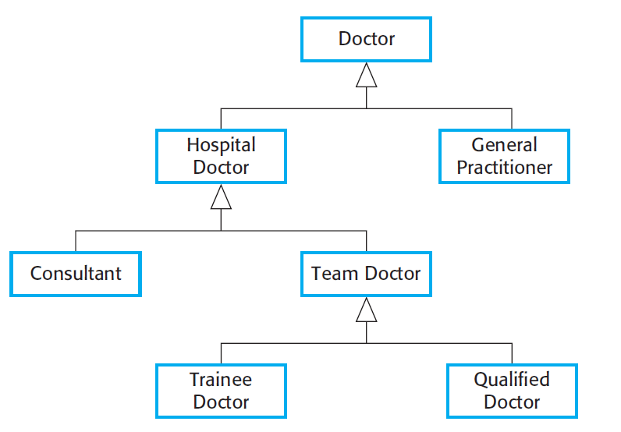
A generalization hierarchy

Slide 54
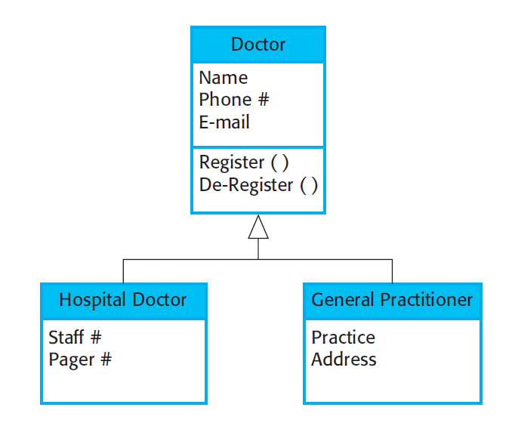
A generalization hierarchy with added detail

Slide 55
Object class aggregation models
An aggregation model shows how classes that are collections are composed of other classes.
Aggregation models are similar to the part-of relationship in semantic data models.

Slide 56
Association Relationships (Cont’d)
We can model objects that contain other objects by way of special associations called aggregations and compositions.
An aggregation specifies a whole-part relationship between an aggregate (a whole) and a constituent part, where the part can exist independently from the aggregate. Aggregations are denoted by a hollow-diamond adornment on the association.
Car
Engine
Transmission

Slide 57
Association Relationships (Cont’d)
A composition indicates a strong ownership and coincident lifetime of parts by the whole (i.e., they live and die as a whole). Compositions are denoted by a filled-diamond adornment on the association.
Window
Scrollbar
1
1
Titlebar
1
1
Menu
1
1 .. *

Slide 58
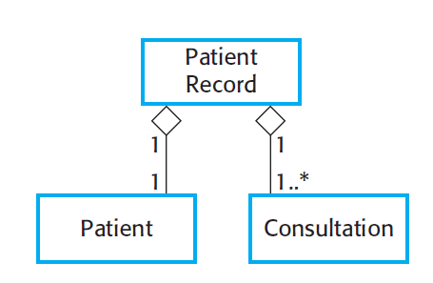
The aggregation association

Slide 59
Behavioral models
Behavioral models are models of the dynamic behavior of a system as it is executing. They show what happens or what is supposed to happen when a system responds to a stimulus from its environment.
You can think of these stimuli as being of two types:
Data Some data arrives that has to be processed by the system.
Events Some event happens that triggers system processing. Events may have associated data, although this is not always the case.

Slide 60
Data-driven modeling
Many business systems are data-processing systems that are primarily driven by data. They are controlled by the data input to the system, with relatively little external event processing.
Data-driven models show the sequence of actions involved in processing input data and generating an associated output.
They are particularly useful during the analysis of requirements as they can be used to show end-to-end processing in a system.

Slide 61
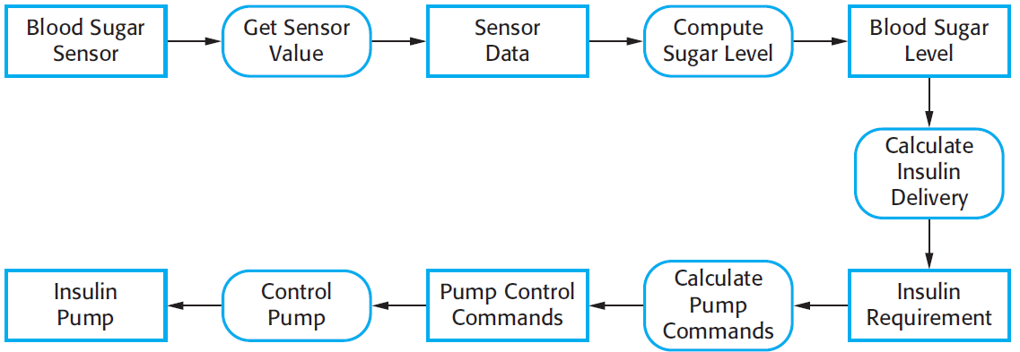
An activity model of the insulin pump’s operation

Slide 62
Event-driven modeling
Real-time systems are often event-driven, with minimal data processing. For example, a landline phone switching system responds to events such as ‘receiver off hook’ by generating a dial tone.
Event-driven modeling shows how a system responds to external and internal events.
It is based on the assumption that a system has a finite number of states and that events (stimuli) may cause a transition from one state to another.

Slide 63
State machine models
These model the behaviour of the system in response to external and internal events.
They show the system’s responses to stimuli so are often used for modelling real-time systems.
State machine models show system states as nodes and events as arcs between these nodes. When an event occurs, the system moves from one state to another.

Slide 64
State Machine
start state
final state
simple state
concurrent composite state
sequential composite state

Slide 65
State Machine
download course offerings
downloading
unscheduled
make a course selection
selecting
make a different selection
verify selection
verifying
select another course
check schedule
sign schedule
checking schedule
scheduled

Slide 66
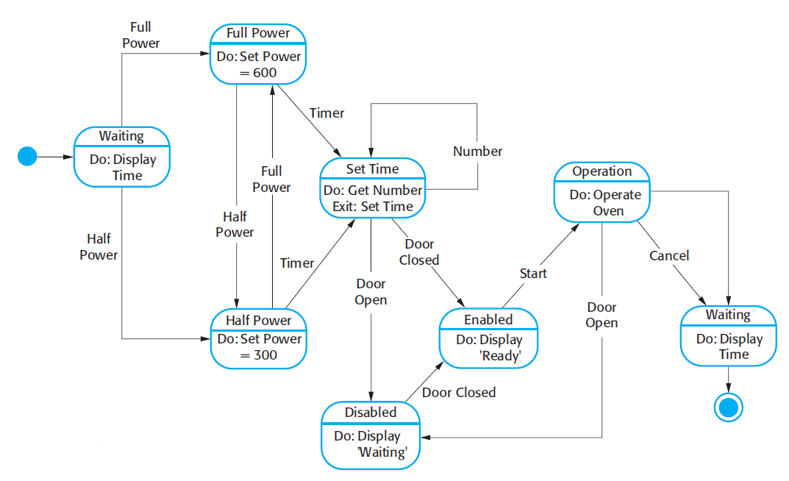
State diagram of a microwave oven

Slide 67
Key points
Behavioral models are used to describe the dynamic behavior of an executing system. This behavior can be modeled from the perspective of the data processed by the system, or by the events that stimulate responses from a system.
Activity diagrams may be used to model the processing of data, where each activity represents one process step.
State diagrams are used to model a system’s behavior in response to internal or external events.

Slide 68
Reading

Slide 69
Model-driven engineering
Model-driven engineering (MDE) is an approach to software development where models rather than programs are the principal outputs of the development process.
The programs that execute on a hardware/software platform are then generated automatically from the models.
Proponents of MDE argue that this raises the level of abstraction in software engineering so that engineers no longer have to be concerned with programming language details or the specifics of execution platforms.

Slide 70
Usage of model-driven engineering
Model-driven engineering is still at an early stage of development, and it is unclear whether or not it will have a significant effect on software engineering practice.
Pros
Allows systems to be considered at higher levels of abstraction
Generating code automatically means that it is cheaper to adapt systems to new platforms.
Cons
Models for abstraction and not necessarily right for implementation.
Savings from generating code may be outweighed by the costs of developing translators for new platforms.

Slide 71
Model driven architecture
Model-driven architecture (MDA) was the precursor of more general model-driven engineering
MDA is a model-focused approach to software design and implementation that uses a subset of UML models to describe a system.
Models at different levels of abstraction are created. From a high-level, platform independent model, it is possible, in principle, to generate a working program without manual intervention.

Slide 72
Types of model
A computation independent model (CIM)
These model the important domain abstractions used in a system. CIMs are sometimes called domain models.
A platform independent model (PIM)
These model the operation of the system without reference to its implementation. The PIM is usually described using UML models that show the static system structure and how it responds to external and internal events.
Platform specific models (PSM)
These are transformations of the platform-independent model with a separate PSM for each application platform. In principle, there may be layers of PSM, with each layer adding some platform-specific detail.

Slide 73
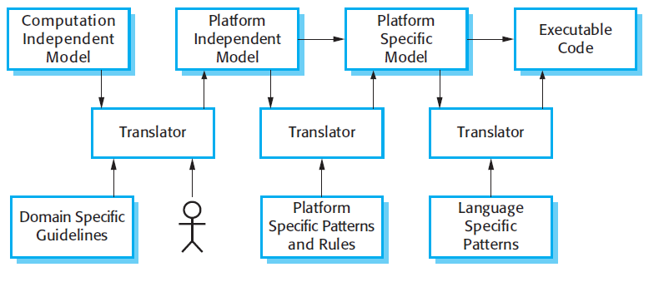
MDA transformations

Slide 74
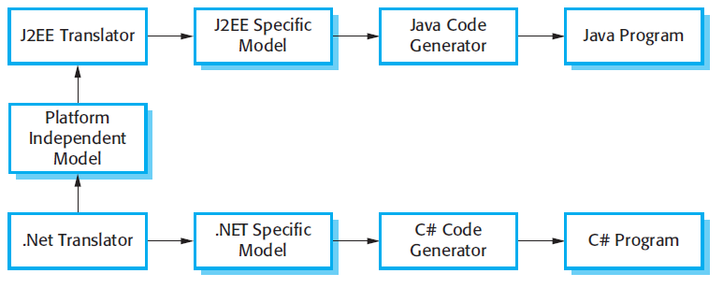
Multiple platform-specific models

Slide 75
Agile methods and MDA
The developers of MDA claim that it is intended to support an iterative approach to development and so can be used within agile methods.
The notion of extensive up-front modeling contradicts the fundamental ideas in the agile manifesto and I suspect that few agile developers feel comfortable with model-driven engineering.
If transformations can be completely automated and a complete program generated from a PIM, then, in principle, MDA could be used in an agile development process as no separate coding would be required.

Slide 76
Executable UML
The fundamental notion behind model-driven engineering is that completely automated transformation of models to code should be possible.
This is possible using a subset of UML 2, called Executable UML or xUML.

Slide 77
Features of executable UML
To create an executable subset of UML, the number of model types has therefore been dramatically reduced to these 3 key types:
Domain models that identify the principal concerns in a system. They are defined using UML class diagrams and include objects, attributes and associations.
Class models in which classes are defined, along with their attributes and operations.
State models in which a state diagram is associated with each class and is used to describe the life cycle of the class.
The dynamic behavior of the system may be specified declaratively using the object constraint language (OCL), or may be expressed using UML’s action language.

Slide 78
Key points
Model-driven engineering is an approach to software development in which a system is represented as a set of models that can be automatically transformed to executable code.

